Slide 1
Learning Objectives
In this chapter you should establish an understanding of:
The six parts of the financial system
The core principles of money and banking
Money and its functions
Payments system today and tomorrow
Money links: inflation and economic growth
Indian Financial System

Slide 2
Introduction
Every financial transaction has a story.
There is a complex web of interdependent institutions and markets making up the foundation of daily financial transactions:
  The Six Parts of the Financial System.
  The Five Core Principles of Money and Banking.

Slide 3
Six Parts of the Financial System
Money
To pay for purchases and store wealth.
Financial Instruments
To transfer resources from savers to investors and to transfer risk to those best equipped to bear it.
Financial Markets
To buy and sell financial instruments.
Financial Institutions
To provide access to financial markets, collect information & provide services.
Regulatory Agencies
To provide oversight for financial system.
Central Banks
To monitor financial Institutions and stabilize the economy.

Slide 4
Six Parts of the Financial System
Money
  Money has changed from gold/silver coins to paper currency to electronic funds.
  Cash can be obtained from an ATM any where in the world.
  Bills are paid and transactions are checked online.

Slide 5
Six Parts of the Financial System
Financial instruments
  Transfers resources from savers to investors
  Buying and selling individual stocks used to be only for the wealthy.
  Today we have mutual funds and other stocks available through banks or online.
  Putting together a portfolio is open to everyone.

Slide 6
Six Parts of the Financial System
Financial Markets
  Allow the buying and selling of financial instruments easily
  Went from being in coffee houses and tavern to well organized markets like the New York Stock Exchange.
  Now transactions are mostly handled by electronic markets.
    This has reduced the cost of processing financial transactions making the way for a much broader array of financial instruments available.

Slide 7
Six Parts of the Financial System
Financial Institutions
  Provide all the services of the financial system like providing access to financial markets and gathering information
  Banks began as vaults, developed into institutions that accepted deposits and gave loans, and evolved to today’s financial supermarket.

Slide 8
Six Parts of the Financial System
Government regulatory agencies
  Make sure the elements of the financial system operate safely and reliably.
  Government regulatory agencies were introduced by federal government after the Great Depression.
  They provide wide-ranging financial regulation, rules, and supervision; and examine the systems a bank uses to manage its risk.

Slide 9
Six Parts of the Financial System
Central banks
  They monitor and stabilize the financial system
  Central banks began as large private banks to finance wars.
  Central banks control the availability of money and credit to promote low inflation, high growth and stability of financial system.
  Today’s policymakers strive for transparency in their operations.
  The Financial crisis of 2007-2009 have lead the US central bank to try many new policy tools.

Slide 10
Five Core Principles of
Money and Banking
Time has value.
Risk requires compensation.
Information is the basis for decisions.
Markets determine prices and allocation resources.
Stability improves welfare.

Slide 11
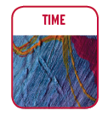
Five Core Principles of
Money and Banking
Core Principle 1: Time has value
Time affects the value of financial instruments.
Interest is paid to compensate the lenders for the time the borrowers have their money.
Latter we will develops an understanding of interest rates and how to use them.

Slide 12

Five Core Principles of
Money and Banking
Core Principle 2: Risk requires compensation
In a world of uncertainty, individuals will accept risk only if they are compensated.
In the financial world, compensation comes in the form of explicit payments: the higher the risk the bigger the payment.

Slide 13

Five Core Principles of
Money and Banking
Core Principle 3: Information is the basis for decisions
The more important the decision, the more information we gather.
Collection and processing of information is the foundation of the financial system.

Slide 14

Five Core Principles of
Money and Banking
Core Principle 4: Markets determine prices and allocate resources
Markets are the core of the economic system.
Markets channel resources and minimize the cost of gathering information and making transactions.
In general, the better developed the financial markets, the faster the country will grow.

Slide 15

Five Core Principles of
Money and Banking
Core Principle 5: Stability improves welfare
A stable economy reduces risk and improves everyone's welfare.
Financial instability in the autumn of 2008 triggered the worse global downturn since the Great Depression.
A stable economy grows faster than an unstable one.
One of the main roles of central banks is stabilizing the economy.

Slide 16
Money and How We Use It
Money is an asset that is generally accepted as payment for goods and services or repayment of debt.

Slide 17
Money and How We Use It
Money has three characteristics:
It is a means of payment
It is a unit of account, and
It is a store of value.
The first of these characteristics is the most important

Slide 18
Money and How We Use It
Means of Payment
People insist on payment in money.
  Barter requires a “double coincidence of wants”.
Money is easier and finalizes payments so there is no further claim on buyers and sellers.
The increase in the numbers of buyers and sellers requires something like “money” to make transactions smoother.

Slide 19
Money and How We Use It
Unit of Account
Money is used to quote prices and record debts - it is a standard of value.
Prices provide the information needed to ensure resources are allocated to their best uses.

Slide 20
Money and How We Use It
Store of Value
A means of payment has to be durable and capable of transferring purchasing power from one day to the next.
Paper currency does degrade, but is accepted at face value in transactions.
Other forms of wealth are also a store of value: stocks, bonds, houses, etc.

Slide 21
Money and How We Use It
Store of Value (cont.)
Although other stores of value are sometimes better than money, we hold money because it is liquid.
Liquidity is a measure of the ease with which an asset can be turned into a means of payment.
  The more costly it is to convert an asset into money, the less liquid it is.

Slide 22
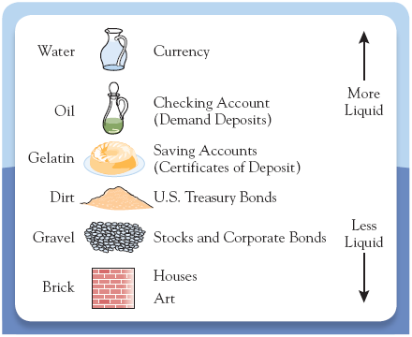
Figure 2.2 - The Liquidity Spectrum

Slide 23
A demand deposit is an account with a bank or other financial institution that allows the depositor to withdraw his or her funds from the account without warning or with less than seven days' notice.
A checking account (current account) is a type of bank deposit account that is designed for everyday money transactions
A checking account is a type of bank deposit account that is designed for everyday money transactions. The money in a savings account, however, is not intended for daily use, but is instead meant to stay in the account — be saved in the account — so that it might earn interest over time.

Slide 24
Saving Account (certificate of deposits: Fixed Deposits) is a time deposit, a financial product commonly sold by banks.

Slide 25
The Payments System
The payments system is a web of arrangements that allow for the exchange of goods and services, as well as assets.
  The efficient operation of the economy depends on the payments system.
Money is at the heart of the payments system.

Slide 26
The Payments System
The possible methods of payment are:
  Commodity and Fiat Monies
  Checks
  Electronic Payments

Slide 27
Commodity and Fiat Monies
Commodity monies are things with intrinsic value.
  Included items like silk and salt.
To be successful, a commodity money must be:
  Usable by most people,
  Durable,
  Easily transportable, and
  Divisible into smaller units.

Slide 28
Commodity and Fiat Monies
Gold coins and notes, backed by gold, were used into the 20th century.
Today’s paper money is called fiat money, because its value comes from government decree, or fiat.
In the end, money is about trust.

Slide 29
Electronic Payments
Electronic payments take the form of:
  Credit and debit cards
  Electronic funds transfers
  Stored-value card
  E-money

Slide 30
Electronic Payments
Debit Cards
  Works like a check - tells the bank to transfer funds from your account to another.
  After 2007, the use of debit cards increased significantly
Credit Cards
  A promise by a bank to lend the cardholder money to make a purchase.

Slide 31
Electronic Payments
Electronic funds transfers
  Movements of funds directly from one account to another.
  Banks use electronic transfers to handle transaction among themselves.

Slide 32
A Brief Overview of Indian Financial System

Slide 33
A Brief Overview of
Indian Financial System
Historically, banks have played the role of intermediaries between savers and the investors.
Indian Banking System (IBS) consists of commercial banks, co-operative banks, development banks & Post-office saving banks & regulatory banks among others.
Commercial Banks account for 90 per cent of the banking system assets.
Public Sector Banks dominate the banking industry in India.
Since liberalization, private banks and foreign banks have established their niche in Indian Banking Sector.

Slide 34
Structure of Commercial Banks in India
Public Sector Banks Private Banks Foreign Banks
(under Indian ownership)
State Bank of India ICICI Bank HSBC
Bank of Baroda HDFC Bank Bank of Tokyo
Bank of Maharashtra Kotak Mahindra Standard
Punjab Nat. Bank Yes Bank Chartered
Union Bank ING-Vysya City Bank
Allahabad Bank Centurion Bank Deutsche Bank
Central Bank of India ABN-AMRO

Slide 35
Basic Terminologies
Item | Description
Deposits | Deposits or rather checkable deposits are bank accounts that allow the owner of the account to write checks to third parties. Includes both interest bearing (savings) & non-interest bearing (current) accounts. It is low cost bearing investment but with high liquidity.
Term deposits | These have a fixed maturity period ranging from several months to over 5 years. It includes penalty for premature withdrawals. These are less liquid than savings account but has a higher return. These are a costly source of funds for the banks.
Borrowings | Banks also obtain funds by borrowing from the Reserve Bank of India & other banks. Borrowings from the RBI are called advances. Banks borrow funds from the RBI overnight and also through short term instruments like repo & reverse repo ranging from a day to 14 days.
Capital | Bank capital is raised by issuing new equity or from retained earnings. It acts as a cushion against a drop in the value of its assets,which could force the banks into insolvency.

Slide 36
Item | Description
Asset | A bank uses the funds it has acquired by issuing liabilities to purchase income earning assets. These are essentially the uses of funds and the interest payments earned on them that enable banks to earn profits.
Reserves | Reserves are the deposits plus some currency that is physically held by banks. These do not earn any interest. It is held in two forms- statutory reserves (CRR & SLR) and excess reserves – these are the most liquid of all bank assets and can be used to meet bank’s obligation if funds are withdrawn from the bank by customers.
Securities | An important income-earning asset. They are in the form of Central government securities, state government securities and other securities.
Loans | Main source of Bank’s profit. It is a liability for the individual who borrows but an asset for banks at it provides income in the form of interest difference. Less liquid than other assets as its liquidity depends upon maturity of loans.
Other Assets | The physical assets - bank buildings, computers , and other equipment owned by the banks is included in this category.

Slide 37
Money Multiplier Process…
Money Multiplier – The process of deposit creation by the commercial banks to a certain multiple of the cash ratio.
Assumptions: (I) Two banks-B₁,B₂ (II) Cash-deposit ratio 10 per cent. (III) n number of individuals.
Suppose individual X deposits Rs. 100 in bank B₁.
Reserve ratio being 10 per cent, bank B₁ has excess cash of Rs. 90.
Now, bank B₁ lends Rs. 90 to bank B2 to earn profit.
B₂ receives Rs. 90 in cash and has an excess cash reserve of Rs. 81.
Thus Bank B₂ can use this to extend loans to credit-worthy borrowers.
If these loans are used to pay clients of B₁ , then B1 receives Rs. 81 and holds Rs. 72.90 as excess reserves.
This excess reserves could be lent again and the cycle continues.
Total deposit creation is given by initial deposit of cash- Rs.100*10

Slide 38
Algebraically, we have
Let D be equal to deposits, Cb cash of banks, b the reserve ratio.
Then ∆D =∆C_{b}+ (1-b)∆C_{b}+(1-b)²∆C_{b}+(1-b)³∆C_{b} +
…………………………………….
+ (1-b)^{n}∆C_{b}.
To sum, ∆D (Total Money SS) =1/b ∆C_{b}
It implies that a bank can raise deposits by an amount equal to change in cash multiplied by the reciprocal of the banks reserve ratio (b).
The money multiplier is the reciprocal of the reserve ratio.

Slide 39
The Banking System example :
Multiple-deposit expansion
Assumptions:
  20% required reserves
  All banks “loaned up”
  Banks lend all of their excess reserves
A $100 bill is found and deposited
Multiple deposits can be created
Notes:
As the checks of one bank are deposited into another, new money is created which leads to even more new money being created and so on and so forth.

Slide 40
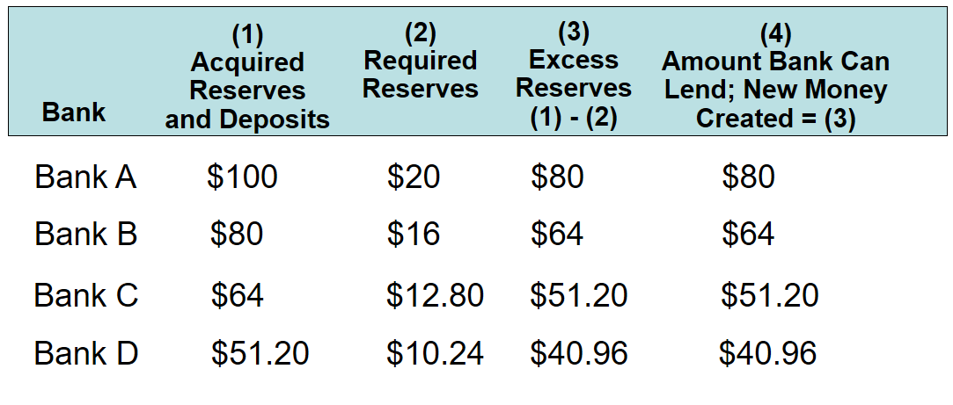
Multiple Bank Expansion LO 4
The process will continue…
Notes:
This table illustrates the creation of new money based on a single $100 deposit made into one bank. Each subsequent bank can lend a smaller portion of $100 after factoring in their reserve requirement, but overall total deposits in all banks will increase.

Slide 41
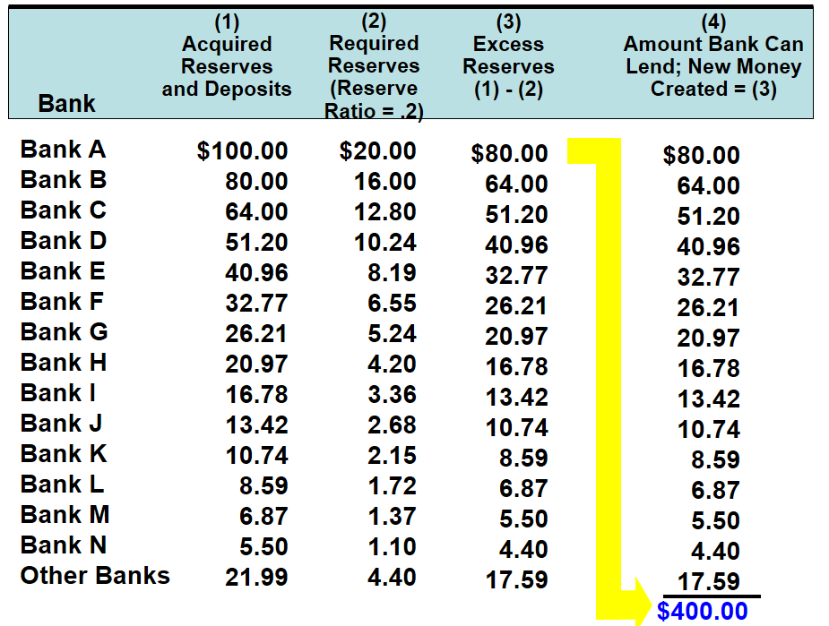
Multiple Bank Expansion Illustration LO 4
Notes:
This shows that, in total, the original $100 deposit will end up adding $400 in new money into the system.

Slide 42
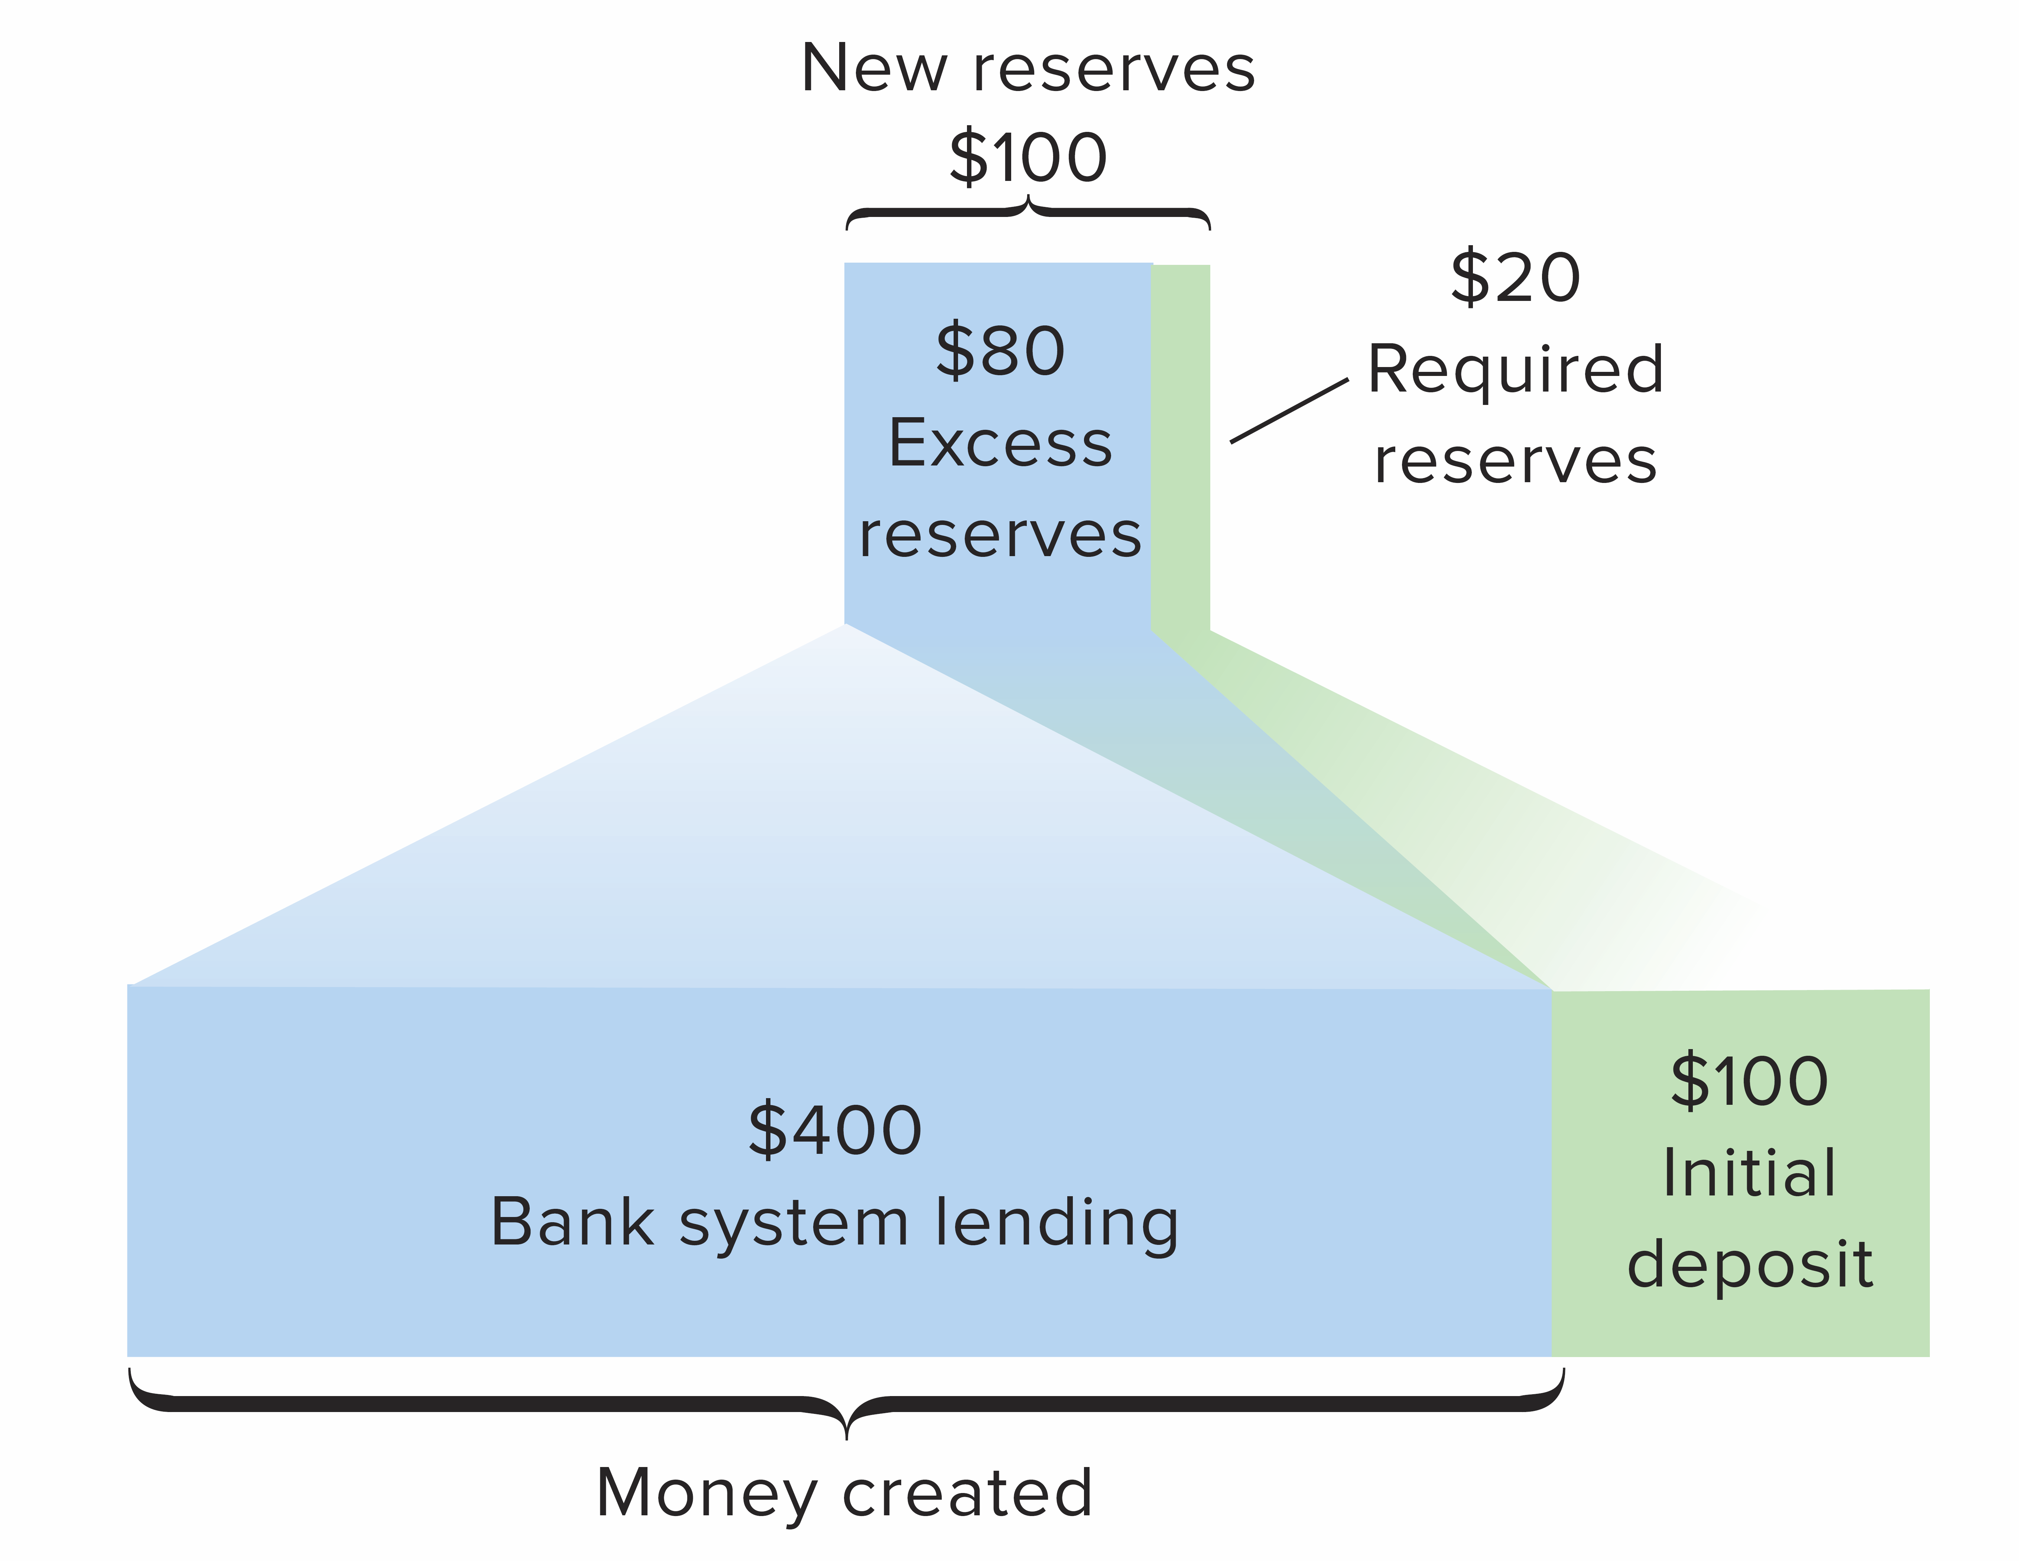
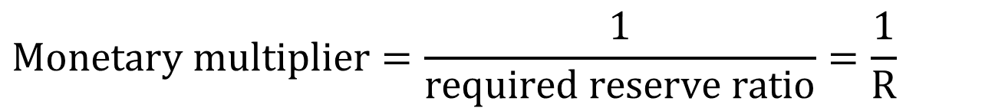
The Monetary Multiplier 1 of 2
LO5
$Monetary multiplier=\frac{1}{required reserve ratio}=\frac{1}{R}$
Notes:
The money multiplier is a key measure in banking that helps to predict the money supply that will be available to drive economic growth. As you can see from the formula, if the reserve requirement is 20%, the money multiplier will be 1 divided by 0.2, which is 5. We can then use the money multiplier multiplied by the excess reserves to determine the maximum checkable-deposit creation that will be provided by the new money entering the system.

Slide 43
The Monetary Multiplier 2 of 2
LO5
Maximum amount of new money created by a single dollar of excess reserves
Higher R, lower m
Reversibility
  Making loans creates money
  Loan repayment destroys money
Notes:
Ironically, one of the items that is slowing current economic growth is people paying down credit card balances and other loans; this is, in effect, removing money from the system.

Slide 44
The Money Multiplier
It exhibits the relationship between the aggregate monetary base and the money supply.
It involves the choice of an appropriate monetary base.
It is important because changes in money multiplier affects the implementation of the monetary policy.
Crucial for maintaining price stability in the economy.
RBI controls large portion of changes in money supply by controlling the changes in the monetary base ─ M₀.

Slide 45
Money Supply = Money Multiplier x Monetary Base
The money supply is equal to the money multiplier times the monetary base and is greater than one.

Slide 46
Monetary Aggregates
Monetary Aggregate | Definition
Reserve money (M₀) Or Monetary Base | Currency in Circulation + Bankers' Deposits with the RBI + 'Other' Deposits with the RBI.
Narrow Money (M1) | Currency with the Public + Demand Deposits with the Banking System + 'Other' Deposits with the RBI

Slide 47
Monetary Aggregate | Definition
M₂ ( Broad Money) | M1 + Saving deposits with post office saving banks

Slide 48
Monetary Aggregate | Definition
M₃ ( Broad Money) | M1+Time deposits with the banking system

Slide 51
The Repo Market
Introduced in the 1990s in the Indian Financial System.
A repo or reverse repo is a transaction in which two parties agree to sell and repurchase the same security.
The contract−
Seller sells a specified security with an agreement to repurchase the same at a mutually decided future date & price.
Buyer purchases a specified security with an agreement to resell the same at a mutually decided future date & price.
Repo − from the view point of seller.
Reverse Repo − from the view point of buyer.

Slide 52
Repo and Reverse Repo Rate
A Repo is a repurchase agreement in which the central bank buys bonds with the agreement that the seller will repurchase within a short period ranging from 1 to 15 days. In a Reverse Repo, the bank sells bonds and the buyer agrees to sell them back within a short period.

Slide 53
  What is CRR ?
  The CRR refers to the cash which banks have to maintain with the RBI as a percentage of their demand and time liabilities (DTL).
RBI uses CRR either to drain excess liquidity or to release funds needed for the growth of the economy from time to time. Increase in CRR means that banks have less funds available and money is sucked out of circulation. Thus we can say that this serves duel purposes i.e.(a) ensures that a portion of bank deposits is kept with RBI and is totally risk-free, (b) enables RBI to control liquidity in the system.

Slide 54
What is SLR ?
SLR stands for Statutory Liquidity Ratio.
This term is used by bankers and indicates the minimum percentage of deposits that the bank has to maintain in form of gold, cash or govt approved securities. It regulates the credit growth in India.

Slide 55
What is Bank rate?
Bank Rate is the rate at which central bank of the country (in India it is RBI) allows finance to commercial banks.
Bank Rate is a tool, which central bank uses for short-term purposes. Any upward revision in Bank Rate by central bank is an indication that banks should also increase deposit rates as well as Base Rate / Benchmark Prime Lending Rate.
Thus any revision in the Bank rate indicates that it is likely that interest rates on your deposits are likely to either go up or go down, and it can also indicate an increase or decrease in your EMI.

Slide 56
Open – Market Operation
Central bank conducts OMO, when it buys or sells government bonds. To increase the MS.

Slide 57
Key Indicators
Bank rate
CRR
SLR
Repo rate
Reverse Repo Rate

Slide 58
Functions of RBI
Currency authority
Banker to government
Banker’s bank and supervisor
Custodian of foreign exchange

Slide 59
Targets of Monetary Policy
Economic growth.
Price stability.

Slide 60
Sources of Financial News
Daily
  The Wall Street Journal
  Financial Times
  Bloomberg.com
  Yahoo! Finance
Weekly
  The Economist
  Business Week
Data
  The Federal Reserve Board of St. Louis (FRED)
  Bureau of Labor Statistics
  Bureau of Economic Analysis
Personal Financial Information
  www.choosetosave.org
  www.dinkytown.net
  www.wsj.com

